Slide 1
Module 1
Introduction and Analysis of Members

Slide 2
Prestressed Concrete
Definition:- Application of permanent compressive stress to material like concrete, which is strong in compression and weak in tension increases the apparent tensile strength of that material, because the subsequent application of tensile stress must firstly nullify the compressive prestress.

Slide 3
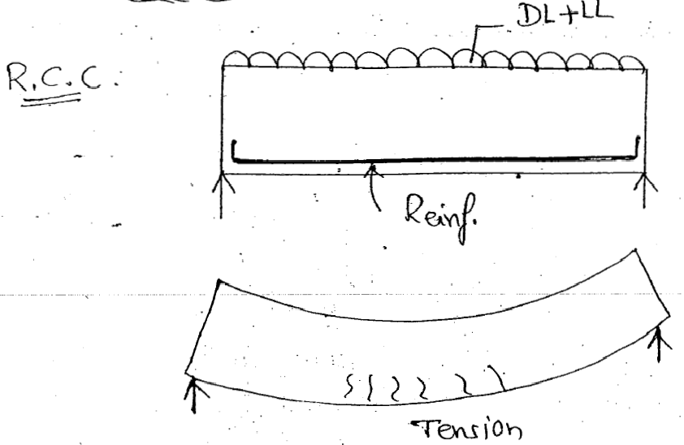

Slide 4
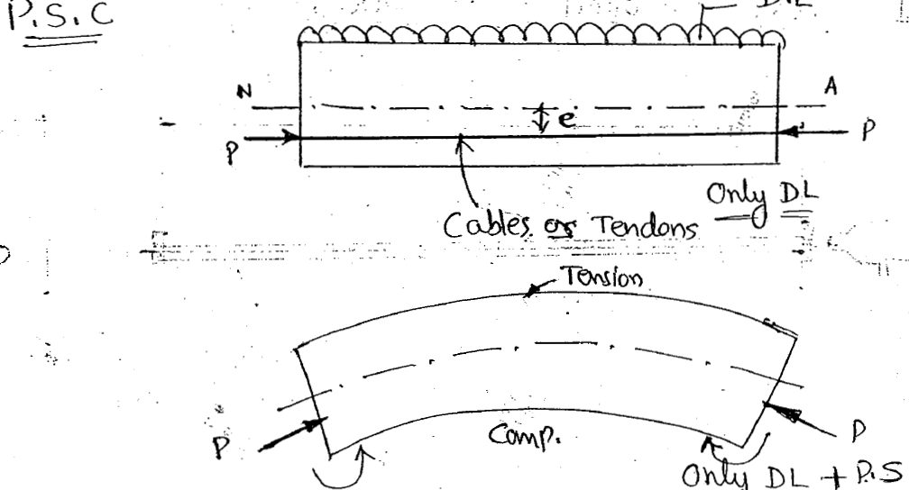
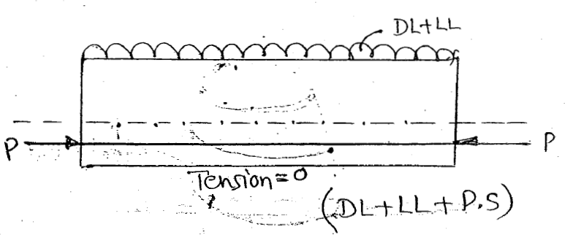

Slide 5
Advantages of PSC
In case fully prestressed member, which are free from tensile stresses, the c/s is more efficiently used.
More resistant to shear, in case of curved cable, particularly in long span members.
More stiffer under working loads.
Use of high strength steel and concrete results in slender sections.
Good resistance to impact loads.
More economical than RCC in long span bridges and foundations.

Slide 6
Disadvantages of PSC
Uneconomical for small span bridges.
Requires anchorages, jacks etc.
Requires skilled labours.
Requires high strength steel and concrete.

Slide 7
Types of Prestressing
Pre-tensioning System

Slide 8
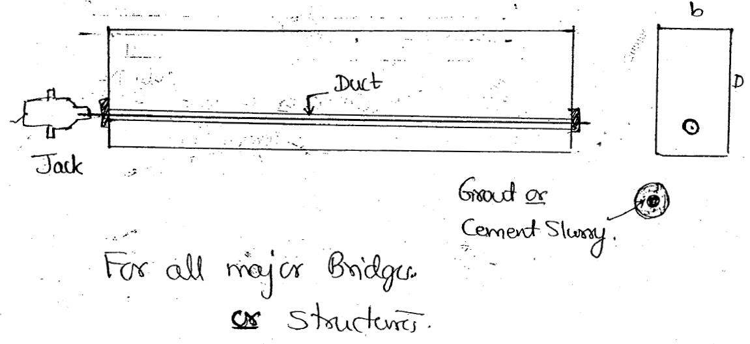
Types of Prestressing
Post tensioning System

Slide 9
Why High Strength Steel and Concrete In PSC?
Attempts to use mild steel in PSC were not successful – working stress 120 N/mm2 – lost – elastic deformation, creep, shrinkage of concrete.
Normal Loss of stress – 100 to 240 N/mm2 – therefore initial stress – high – 1200 to 2000 N/mm2 – these high stress is possible – use of High strength steel.

Slide 10
As PSC offers high resistance to tension, shear, bond and bearing.
Resistance to high bearing stresses in anchorage zones.
To minimize the cost
Resistance to Creep strain and shrinkage cracks.
To reduce the c/s dimension of PSC elements with reduced DL.
Longer spans or sections become technically and practically achievable.

Slide 11
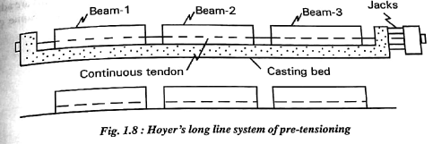
Prestressing Systems

Slide 12
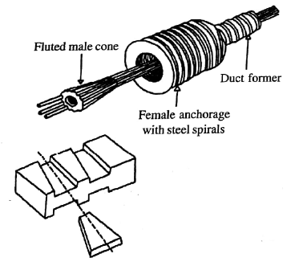
The Freyssinet System

Slide 13
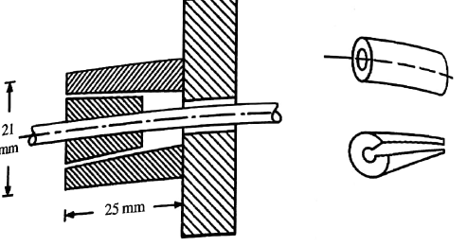
Gifford Udall System

